Slide 1
Serverless architecture
Notes:
Information in this document, including URL and other Internet Web site references, is subject to change without notice. Unless otherwise noted, the example companies, organizations, products, domain names, e-mail addresses, logos, people, places, and events depicted herein are fictitious, and no association with any real company, organization, product, domain name, e-mail address, logo, person, place or event is intended or should be inferred. Complying with all applicable copyright laws is the responsibility of the user. Without limiting the rights under copyright, no part of this document may be reproduced, stored in or introduced into a retrieval system, or transmitted in any form or by any means (electronic, mechanical, photocopying, recording, or otherwise), or for any purpose, without the express written permission of Microsoft Corporation.
Microsoft may have patents, patent applications, trademarks, copyrights, or other intellectual property rights covering subject matter in this document. Except as expressly provided in any written license agreement from Microsoft, the furnishing of this document does not give you any license to these patents, trademarks, copyrights, or other intellectual property.
The names of manufacturers, products, or URLs are provided for informational purposes only and Microsoft makes no representations and warranties, either expressed, implied, or statutory, regarding these manufacturers or the use of the products with any Microsoft technologies. The inclusion of a manufacturer or product does not imply endorsement of Microsoft of the manufacturer or product. Links may be provided to third party sites. Such sites are not under the control of Microsoft and Microsoft is not responsible for the contents of any linked site or any link contained in a linked site, or any changes or updates to such sites. Microsoft is not responsible for webcasting or any other form of transmission received from any linked site. Microsoft is providing these links to you only as a convenience, and the inclusion of any link does not imply endorsement of Microsoft of the site or the products contained therein.
© 2017 Microsoft Corporation. All rights reserved.
Microsoft and the trademarks listed at https://www.microsoft.com/en-us/legal/intellectualproperty/Trademarks/Usage/General.aspx are trademarks of the Microsoft group of companies. All other trademarks are property of their respective owners.

Slide 2

Abstract and learning objectives
Abstract
Setup and configure a serverless architecture, breaking down the solution to smaller components that are individually scalable, and allowing the customer to only pay for what they use.
Learning objectives
Independently scale and break down business logic into discrete components
Use computer vision algorithms within AzureCreate a Logic App to act as a workflow
Monitor the serverless topology, observing how well the solution scales when under load
Implement a Continuous Deployment DevOps process in the serverless architecture
Notes:
Setup and configure a serverless architecture within Azure using a combination of Azure Functions, Logic Apps, Event Grid, Cosmos DB, and Azure Storage. The focus is on removing server management from the equation, breaking down the solution into smaller components that are individually scalable, and allowing the customer to only pay for what they use.
Use a series of Azure Functions that independently scale and break down business logic into discrete components
Use computer vision algorithms within an Azure Function to accurately detect license plates in car images at scale
Provision and use Cosmos DB as a highly available NoSQL data store for processed data
Create a Logic App that contains a workflow to export processed license plates and conditionally send alerts based on successful or unsuccessful operation
Use App Insights to monitor the serverless topology, observing how well the solution scales when under load
Implement a Continuous Deployment DevOps process to automatically publish changes to Function Apps

Slide 3
Step 1: Review the customer case study
Outcome
Analyze your customer needs
Timeframe
15 minutes

Slide 4
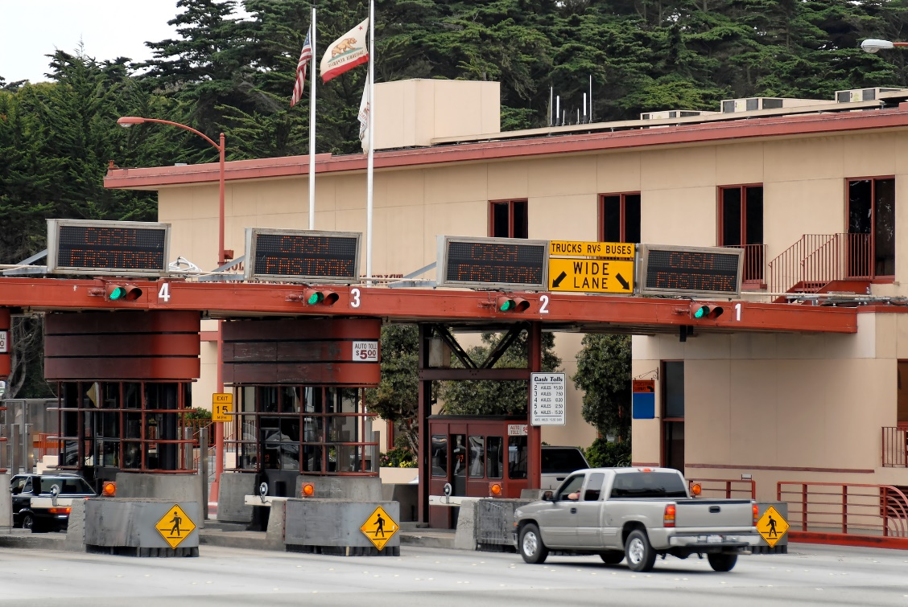
Customer situation
Litware, Inc. manages a number of toll booths, taking photos of vehicles and billing the drivers
License plate detection is currently a manual process
They are trying to cope with being overloaded due to faster-than-expected growth
Notes:
Litware, Inc. added toll booth management as a one-off side project that works with their robust custom-built billing system. Their TollBooth software, which was meant to handle just a handful of local toll booths, had minimal development resources allocated to it. As such, Litware has been using a manual process to identify license plates and send that data to their billing software. As a car passes through a toll booth, a medium resolution image is taken of the car to identify its license plate numbers/characters which will ultimately be used to look up and bill the customer. Currently, they periodically package and send those images to a 3rd party vendor, who manually identifies the license plate numbers and sends the list back to Litware when they are done. At this point, Litware collects batches of 1,000 transactions, saves the information to a CSV file hosted by an FTP server, where their downstream accounting system extracts the license plate information and bills the customer.
They have recently been awarded a very large contract to add an order of magnitude more toll booths they need to manage. Now they are trying to quickly cope with this new growth and automate the license plate detection process.

Slide 5

Customer situation
Litware is confident that their billing system can handle the load
They are concerned about how rapidly they can automate the license plate processing while ensuring the new automated solution can scale to meet demand, especially during spikes in traffic
Notes:
They are confident that their billing software can handle the load, as it has been the primary focus of development from the start, and has expanded into other markets, proving its ability to handle large-scale transactions and data processing. However, Litware is concerned about how rapidly they can automate the license plate processing portion of their TollBooth infrastructure, while ensuring that the automated solution can scale to meet demand, particularly during unexpected spikes in traffic.

Slide 6



Customer situation
Would like to use machine learning service to perform license plate recognition task
Needs to store images in cloud storage and data in database for export and manual verification
Wants an automated workflow to export license plate data and send conditional alerts
Notes:
Since Litware does not have any machine learning experts or data scientists on staff, they would like to know their options for using a ready-made machine learning service that can perform the license plate recognition task on the photos.
They need to store captured vehicle photos in cloud storage for retrieval via custom web and mobile applications. These photos will need to be accessible by the downstream billing service for inclusion on the customer bills. In addition, any photos containing license plates that could not be automatically detected, will need to be marked as such and accessed later on for manual validation. Similarly, as photos are successfully processed for license plate detection, the plate information needs to be saved to a database, along with the capture date/time and tollbooth Id. Litware has a customer service department who can monitor the queue of photos marked for manual validation, and enter the license plates into a web-based form so they can be exported along with the automatically processed license plate data.
They want an automated workflow that runs on a regular interval to extract new license plate data since the last export and save it in a CSV file that gets ingested by the billing software. Customer service has requested that an alert email should be sent to a specific monitoring address if at any point the automated export does not complete due to no data. Given the export interval and the average number of vehicles that pass through the toll booths during any given hour, having no data to export would be the exception, not the rule.

Slide 7




Customer situation
Our directors want to see where we can take the notion of a serverless architecture, and see if there truly are long-term performance and cost benefits.
With the unexpected windfall of the toll booths contract, they want to make sure we have a tested strategy we can fall back on in the future...
Notes:
Litware’s CIO, Abby Burris, believes that the dynamic scalability of serverless components, coupled with sub-second billing, would provide a cost-effective way to quickly build the automated solution using familiar development tools and programming languages to minimize developer training.
The important thing is being able to have a centralized monitoring dashboard they can use to watch the automated process execute in real time, and drill down into captured telemetry if needed.
Burris would like to know if it’s possible to locally develop the serverless components and automate the deployment process using continuous delivery DevOps practices like they can with their more traditional web applications.

Slide 8






Customer needs
Automate manual process using serverless
Use ready-made machine learning service
Manually enter license plate numbers for images that could not be processed
Scalable solution that can handle unexpected demand
Automated workflow that exports data
Options to locally develop and automate deployment pipeline
Centralized monitoring dashboard with real-time and historical viewing options
Notes:
Replace manual process with a reliable, automated solution using serverless components
Take advantage of a machine learning service that would allow them to accurately detect license plate numbers without needing artificial intelligence expertise
Mechanism for manually entering license plate images that could not be processed
Have a solution that can scale to any number of cars that pass through all toll booths, handling unforeseen traffic conditions that cause unexpected spikes in processed images
Establish an automated workflow that periodically exports processed license plate data on a regular interval, and sends an alert email when no items are exported
Would like to locally develop the serverless components and establish an automated deployment pipeline from source control
Use a monitoring dashboard that can provide a real-time view of serverless components, historical telemetry data for deeper analysis, and supports custom alerts

Slide 9

Customer objections
How can the serverless components talk to each other
Will the dynamic scalability of the serverless components end up costing us a lot of money
How do we combat against erroneous image processing
Notes:
We are concerned about how individual serverless components will be able to “talk” to each other and reliably pass messages through the pipeline
Will go to a serverless architecture that has the capacity to infinitely scale put us at risk for huge monthly bills?
How do we make sure that erroneous image processing does not make certain toll bills fall through the cracks or, even worse, send a bill to the wrong person?

Slide 10
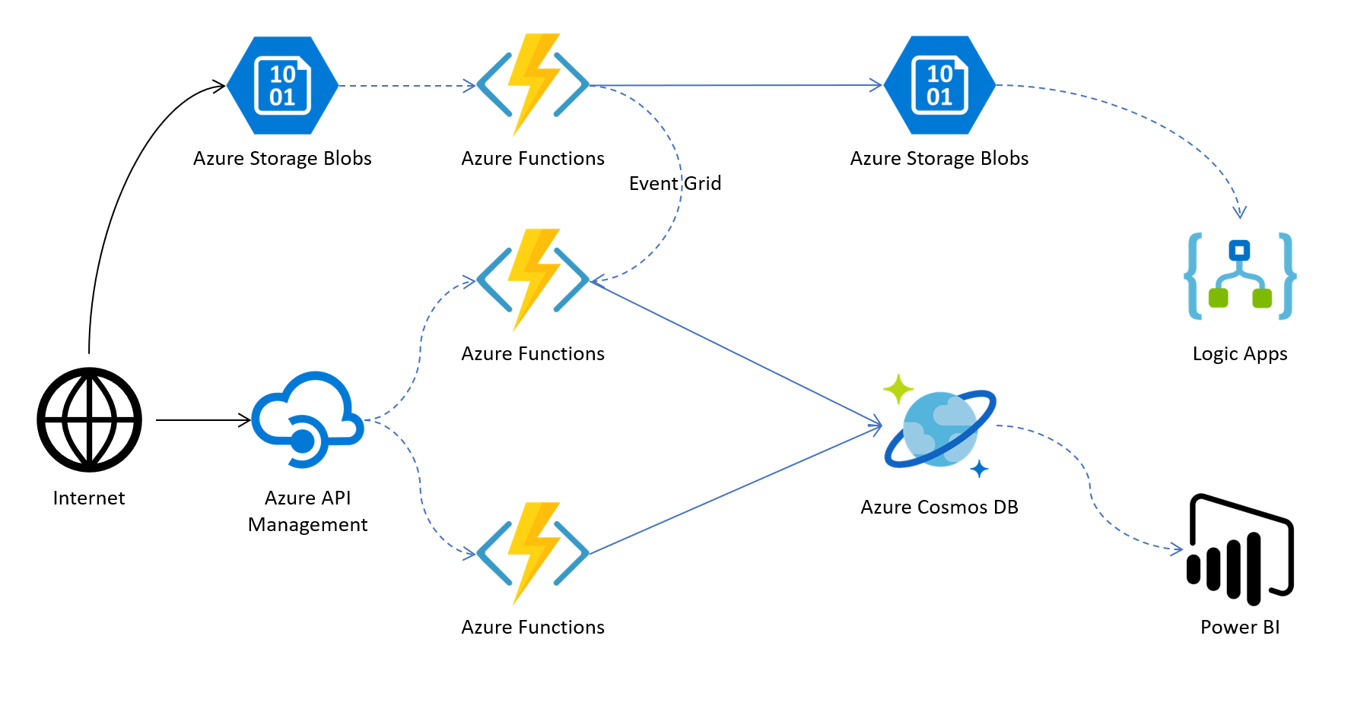
Common scenarios
Notes:
This is a diagram of a common architecture for this type of scenario from which you can draw inspiration. You will find this diagram within the student guide.

Slide 11
Step 2: Design the solution
Outcome
Design a solution and prepare to present the solution to the target customer audience in a 15-minute chalk-talk format.
Timeframe
60 minutes
Business needs (10 minutes) | Respond to questions outlined in your guide and list the answers on a flipchart.
Design (35 minutes) | Design a solution for as many of the stated requirements as time allows. Show the solution on a flipchart.
Prepare (15 minutes) | Identify any customer needs that are not addressed with the proposed solution. Identify the benefits of your solution. Determine how you will respond to the customer’s objections. Prepare for a 15-minute presentation to the customer.

Slide 12
Step 3: Present the solution
Outcome
Present a solution to the target customer in a 15-minute chalk-talk format.
Timeframe
30 minutes (15 minutes for each team to present and receive feedback)
Directions
Pair with another table
One table is the Microsoft team, and the other table is the customer
The Microsoft team presents their proposed solution to the customer
The customer asks one of the objections from the list of objections in the case study
The Microsoft team responds to the objection
The customer team gives feedback to the Microsoft team

Slide 13
Wrap-up
Outcome
Identify the preferred solution for the case study
Identify solutions designed by other teams
Timeframe
15 minutes

Slide 14

Preferred target audience
Abby Burris, Chief Information Officer, Litware, Inc.
The primary audience is business decision makers and technology decision makers
Usually, we talk to the Infrastructure Managers who report into the CIOs, or to application sponsors (like a VP LOB, CMO) or to those that represent the Business Unit IT or developers that report into application sponsors

Slide 15
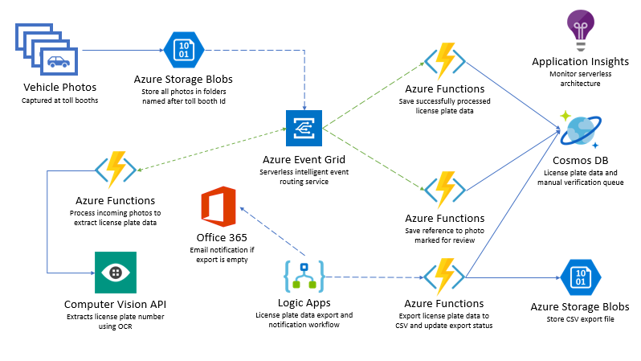
Preferred solution
Notes:
The solution begins with vehicle photos being uploaded to an Azure Storage blobs container, as they are captured. Each photo is stored in a subfolder named after the photo booth’s Id so the Id can be added to the processed license plate data in the database. An Event Grid subscription is created against the Blob storage create event, calling the photo processing Azure Function endpoint (on the left-hand side of the diagram), which in turn sends the photo to the Cognitive Services Computer Vision API OCR service to extract the license plate data. If processing was successful and the license plate number was returned, the function submits a new Event Grid event, along with the data, to an Event Grid topic with an event type called “savePlateData.” However, if the processing was unsuccessful, the function submits an Event Grid event to the topic with an event type called “queuePlateForManualCheckup.” Two separate functions are configured to trigger when new events are added to the Event Grid topic, each filtering on a specific event type, both saving the relevant data to the appropriate Cosmos DB collection for the outcome, using the Cosmos DB output binding. A Logic App that runs on an hourly interval executes an Azure Function via its HTTP trigger, which is responsible for obtaining new license plate data from Cosmos DB and exporting it to a new CSV file saved to Blob storage. If no new license plate records are found to export, the Logic App sends an email notification to the Customer Service department via their Office 365 subscription. Application Insights is used to monitor all of the Azure Functions in real-time as data is being processed through the serverless architecture. This real-time monitoring allows Litware to observe dynamic scaling first-hand and configure alerts when certain events take place.

Slide 16



Preferred solution
License plate processing serverless components
Orchestrate event-driven activities with Event Grid
Use Azure Functions for serverless compute with the Consumption plan
Research and test downstream services to see if they can handle high demand – implement rate-limiting and resiliency strategy as needed
Use Cosmos DB to store license plate data
Notes:
Which Azure messaging service would you recommend using to orchestrate event-driven activities between the serverless components?
- Event Grid for reliable event-driven, reactive programming.
What Azure service would you suggest Litware use to execute custom business logic code when an event is triggered?
- Azure Functions, a serverless compute service that enables you to run your custom business logic code on demand without the need to provision or manage infrastructure, dynamically scales to meet demand, and enables you to pay only for the compute resources used.
Which pricing tier for the service would you recommend that would automatically scale to handle demand while charging only for work that was performed?
- An Azure Functions Consumption plan. In this scenario, none of the functions are particularly long-running, and the Consumption plan meets the requirement that charges are only incurred when work is performed.
How do you ensure that downstream components, such as machine learning APIs, databases, and file stores, are not overloaded by the potential high load created when your serverless components dynamically scale?
- During the design and testing phases of the application development, it is crucial to verify that downstream components can handle the potential high load created by the dynamic scaling of the serverless computing tier. Review external services for rate limits, perform load testing, then configure concurrency settings on the triggers to limit how many HTTP functions can be executed in parallel. Another option is to implement a resiliency strategy in code, such as a retry pattern and/or a circuit breaker pattern, giving the downstream service time to recover.
What Azure service would you recommend for storing the license plate data? Consider options that automatically scale to meet demand, and offer bindings to other serverless components that simplify connecting to and storing data within the data store.
- Use Azure Cosmos DB, which is a globally distributed, massively scalable, multi-model database service that includes native integration with Azure Functions. You can use output bindings directly to Cosmos DB from your functions, simplifying the steps needed to persist your incoming license plate processing data.

Slide 17



Preferred solution
License plate OCR
Use the Cognitive Services Computer Vision API and its built-in OCR capabilities
The image processing function can make a REST call to send the photo and read the JSON data in return
Azure Functions
POSTs photo
Computer Vision API
Extracts text with OCR
JSON Response
Function reads JSON
Notes:
What service would you recommend Litware use to conduct license plate object character recognition (OCR) processing to extract the license plate number from each photo as it enters the system?
- Since Litware has stated that they have no in-house expertise in machine learning or data science, the simplest approach would be to use the Cognitive Services Computer Vision API and its built-in OCR capabilities.
How would you integrate the OCR service to your license plate processing flow?
- The Computer Vision API can be integrated by having the image processing function make a REST request containing the photo to the registered service endpoint. It is highly recommended that a resiliency strategy is implemented for the call, in case the service is imposing rate limits on your requests during high traffic periods. The return data is in JSON format, containing the discovered text and bounding boxes indicating their position within the photo.

Slide 18



Preferred solution
Data export workflow
Create a Logic App with the following:
Recurrence trigger that executes every hour then
Executes Azure function that exports CSV to storage then
Uses conditional logic to evaluate response code from the function and send email using Office 365 Outlook connector
Notes:
What Azure service would you recommend Litware use to create an automated workflow that runs on a regular interval to export processed license plate data and send alerts as needed? - Logic Apps would help integrate an automated workflow without worrying about building hosting, scalability, availability, and management. You would add a recurrence trigger to the logic app that fires on a defined schedule. The logic app would execute the Azure function that collects new processed license plate data and exports it to a CSV file in Azure Storage.
Which other services would you integrate into your workflow?
- Litware has stated that they use Office 365 services for their email. Logic Apps can use the Office 365 Outlook connector to send emails to any number of recipients. Start by adding a condition after the call to the Azure function. This condition needs to evaluate the response code sent by the function to determine whether the email step is fired. If the code is not equal to 200 (OK status), then the email should be sent with information in the body crafted based on the response code. For instance, the function should return a 204 (NoContent) status code if no license plate data was found that needs to be exported. This would indicate that no photos were processed in the period since the previous trigger interval, possibly indicating a situation out of the norm that should be investigated more closely.

Slide 19





Preferred solution
Monitoring and DevOps
Develop & debug Function Apps locally with Azure Functions Core Tools
Automate function deployments through App Service continuous integration – use integrated source repo like GitHub, DropBox or VSTS
Monitor all executing serverless components with App Insights, in real-time, and use it to configure alerts and view historical telemetry
Azure Functions Core Tools
Git Repo
Auto Deploy
App Insights
Notes:
What tools and services would you recommend Litware use to develop the serverless components locally, synchronize with a source code repository, and implement continuous deployment? - The Azure Functions Core Tools is a local version of the Azure Functions runtime that can be run on your local computer for debugging during your development process or running in a local, isolated environment. The best integration is with Visual Studio 2017. Automated deployments of your function app can be facilitated through App Service continuous integration. Use one of the integrated services for your source code repository, such as BitBucket, DropBox, GitHub, and Visual Studio Team Services (VSTS), which enables a workflow whereby a deployment to Azure is triggered when your function code is pushed to your repository.
How would you monitor all the executing serverless components in real time from a single dashboard? - Use Azure Application Insights with built-in integration with Azure Functions. Use the Live Metrics Stream feature to view the incoming requests, outgoing requests, overall health, allocated server information, and sample telemetry in near-real time. This will help you observe how your functions scale under load and allows you to spot any potential bottlenecks or problematic components, through a single interactive interface.
Does your monitoring solution support exploring historical telemetry and configuring alerts? - Yes, Application Insights makes it easy to configure alerts and explore current and historical telemetry and log data.

Slide 20
Customer objections
How can the serverless components talk to each other
Will the dynamic scalability of the serverless components end up costing us a lot of money
How do we combat against erroneous image processing
Notes:
We are concerned about how individual serverless components will be able to “talk” to each other and reliably pass messages through the pipeline.
- Use Event Grid events to trigger certain functions, enabling other functions to send data to the reliable queue through an Event Grid topic, along with specifying a specific event type so that the functions that need to react to the events only do so on the filtered events they care about.
Will transitioning to a serverless architecture that has the capacity to infinitely scale put us at risk for huge monthly bills?
- One of the primary benefits of using serverless components is that billing is based just on resources consumed or the actual time your code is running. For many event-driven workflows, sub-second billing will save more money in the long run compared to paying for constantly running resources, whether they are used or not. When using Azure Functions, short-lived and sporadic use will benefit most from the Consumption plan. However, if you are consistently getting a lot of traffic or have many long-running operations, the App Service plan might be more cost-effective. Most serverless components have an option to put upper limits on things like concurrent executions, and other rate-limiting options.
How do we make sure that erroneous image processing does not make certain toll bills fall through the cracks or, even worse, send a bill to the wrong person?
- Create a manual verification queue when the OCR process fails, or the confidence level of the result is low, indicated by an empty result after filtering out invalid characters. More advanced machine learning models may be employed with algorithms that are specifically tuned to license plate recognition (LPR). Part of the result would include a confidence level, which could be used to decide whether the photo needs manual verification.

Slide 21
Customer quote
“Thanks to Azure’s serverless components, and the ease in which we can use them, we have been able to rapidly build a cost-effective and robust solution to replace our manual license plate recognition process. The first-class monitoring tools we can use with our new architecture has helped us confidently move forward and competently meet the high demands of our expanding customer base.”
Abby Burris, CIO, Litware, Inc.

